Slide 1
Cybersecurity
Virtual Private Networks

Slide 2
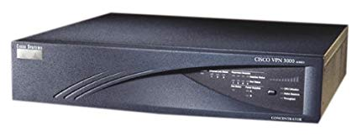
VPN
Virtual Private Network
Encrypted data over untrusted, public network
Concentrator
Device that handles encryption/decryption
Sometimes standalone, sometimes integrated in firewall
Hardware- or Software-based
Client software used to connect remotely

Slide 3






Remote access VPN
Remote device connects to VPN concentrator
Provides private link to company network from afar
Trusted connection over untrusted network
Internet
VPN Concentrator
Remote Laptop
Company Network

Slide 4
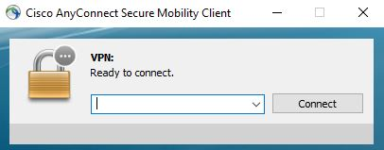
SSL VPN (Secure Sockets Layer VPN)
Uses common SSL/TLS protocol (tcp/443)
Common port, fewer connectivity issues
Authenticates users
No requirement for digital certificates or shared passwords (like IPSec)
Browser-based or VPN client software

Slide 5
Full tunnel
Internet
Company Network

Slide 6
Site-to-Site VPN
Remote Site
VPN Concentrator
VPN Concentrator
Company Network

Slide 7
IPSec (Internet Protocol Security)
OSI Layer 3 Security
Encrypts every packet
Confidentiality and integrity
Encryption and packet signing
No “replay attack” possible (packets signed and timestamped)
Standardized
Supported by most vendors
Two underlying IPSec protocols
Authentication Header (AH)
Encapsulation Security Payload (ESP)

Slide 8
Transport mode and tunnel mode
Original Packet:
IP Header | Data
Transport Mode:
IP Header | IPSec Headers | Data | IPSec Trailers
Tunnel Mode:
New IP Header | IPSec Header | IP Header | Data | IPSec Trailers

Slide 9
Authentication Header (AH)
Hash of the packet and shared key
MD5, SHA-1, or SHA-2 are common
Adds the AH to the packet header
IP Packet with Authentication (tunnel mode)
New IP Header | AH Header | IP Header | Data
Authenticated

Slide 10
Encapsulation Security Payload (ESP)
Encrypts packet
MD5, SHA-1, or SHA-2 for hash
3DES or AES for encryption
Adds header, trailer and Integrity Check Value
IPSec Datagram with ESP (tunnel mode)
Encrypted
New IP Header | ESP Header | IP Header | Data | ESP Trailer | Check Val
Authenticated

